Slide 1

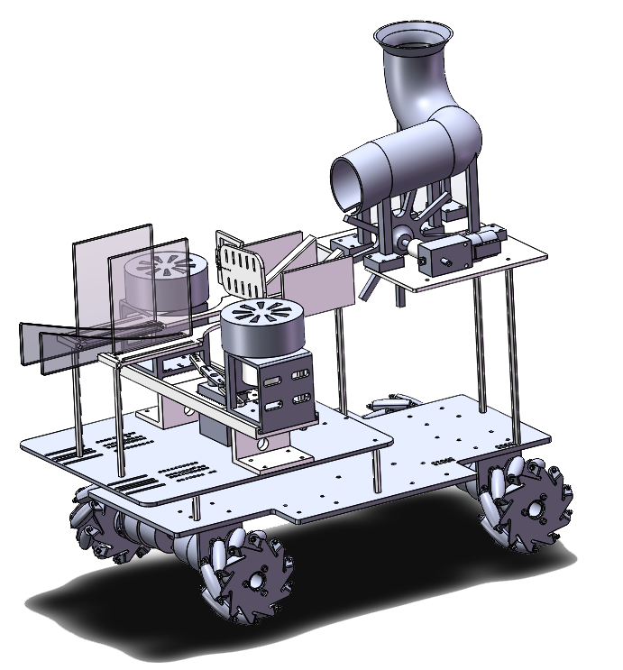

Remotely Controlled Metal Trebuchet
VM250 COURSE PROJECT
Team Member：Yuchen Song, Wei Yan, Jingwen Deng, Minghui Yin, Junjie Li

Slide 2
Introduction
Concept Design
Manufacturing
Cost Estimation
Conclusion
CONTENT

Slide 3
PART Ⅰ 
YOUR SLOGAN HERE
01
Introduction
Project Review
Technical issues
Plan selection
Group 5
Notes:
该项目涉及到的技术问题：可远程遥控智能小车（控制代码），机械结构设计，材料的选择与加工。
我们的小车实现的功能：能遥控，能储存球，能发射不同大小、不同材质的球，发射距离可调。
为什么选择摩擦轮这个方案（利用题目条件计算得到大概的初速度，说明利用摩擦轮能轻易得到所需的出射速度，还可对比其他方案）

Slide 4
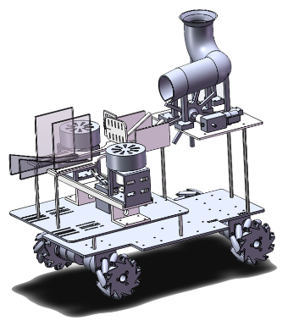
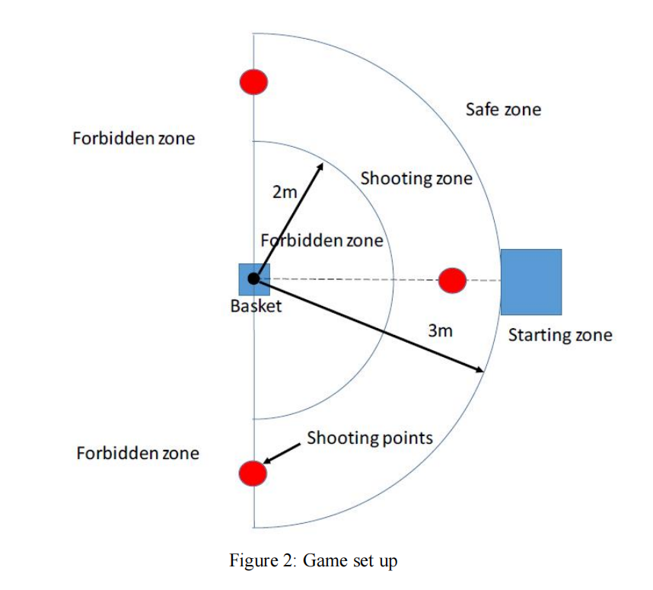
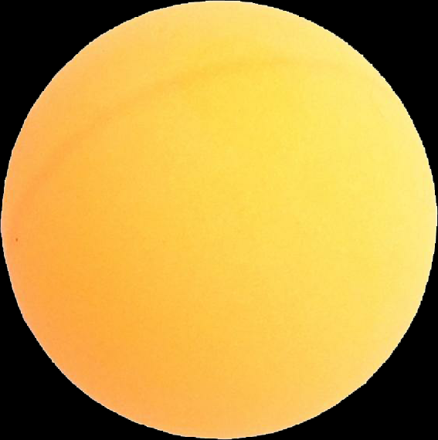
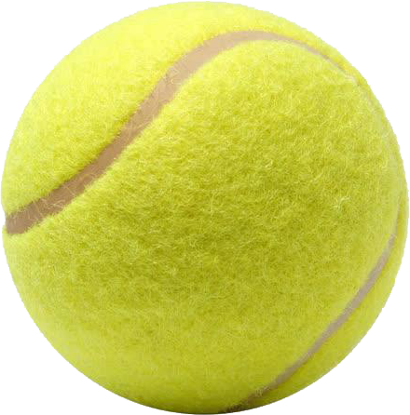
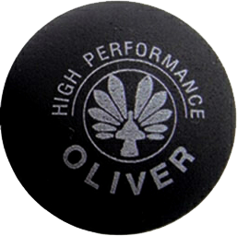
Project Review

Slide 5

Project Review

Slide 6
Technical Issues
Remote Control
Structural Design
Assemble & Manufacture
Bluetooth
Wi-Fi
IR
Shooting
Reloading
Wheels
Laser cutter
3D printer
Metal processing

Slide 7
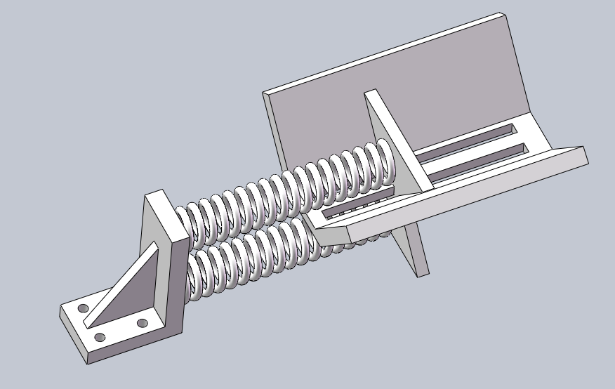
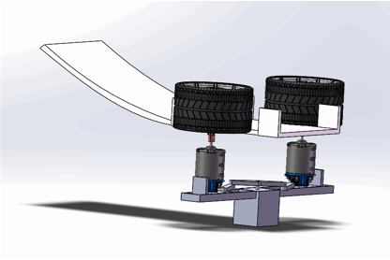

Plan Selection
2 Plans in initial design 
1st Spring Sets
2nd Friction Wheels

Slide 8
PART Ⅱ 
YOUR SLOGAN HERE
02
Concept Design
Moving
Reloading
Shooting
Group 5

Slide 9
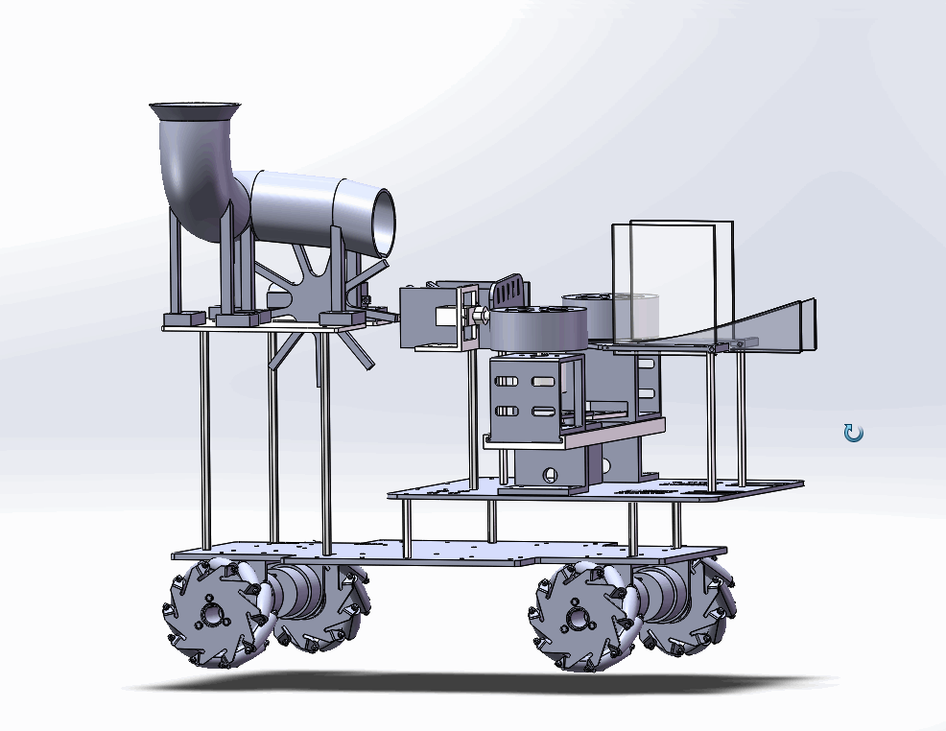
Trebuchet Car Overview

Slide 10
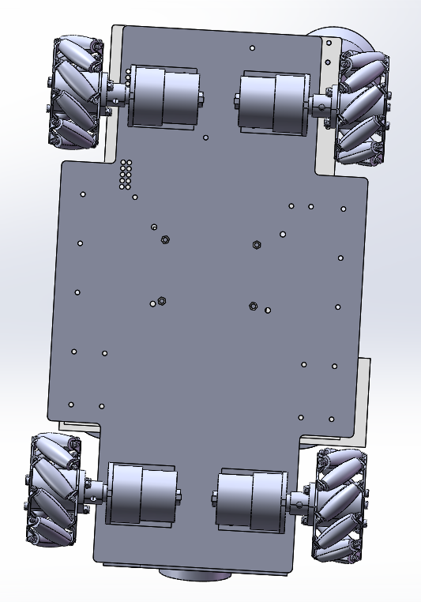
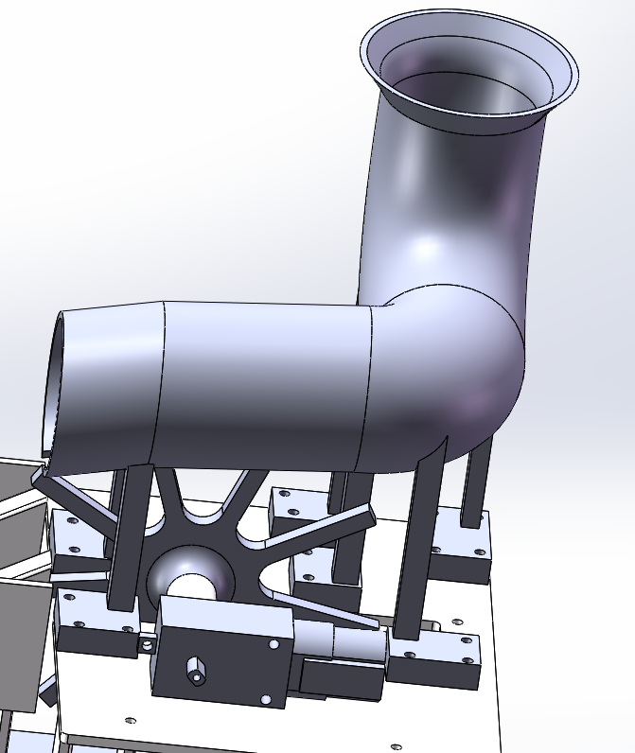
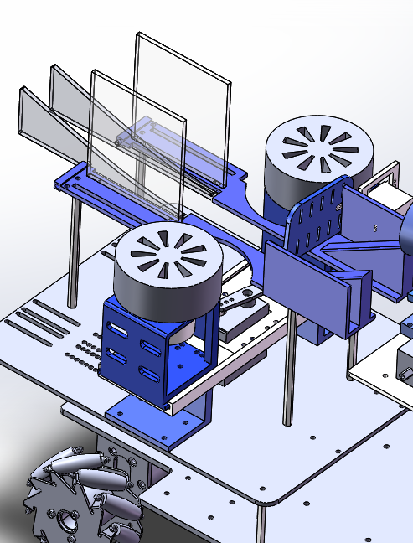





Structure-Function Introduction
Moving
Reloading
Shooting
Moving
Trebuchet
Shooting
Spacing
Reloading
Remote Controlling
Notes:
接下来由我给大家大致介绍清楚我们小车的各结构模块及其功能。
它大概有3个结构模块，分别是：移动装置、重载装置和发射装置。
然后我们从小车的实体结构来介绍它们的功能。
首先看到的是移动装置这部分的模型。
Next, I will give a introduction of our car's functional modules and relevant structures.
It has about three structural modules, they are: moving device, reloading device and launch device.
Then we will learn about their functions from the physical structure of the cars.
The first thing you see is the model of the moving device.

Slide 11
Structure-Function Introduction
Mecanum wheel 
Realize omni-directional movement, including forward movement, horizontal movement, oblique movement, rotation and its combination
Moving device
Notes:
在这部分，我们是采用了麦克纳姆轮来支持小车的运动行进。它是一种全向轮。
特点：能够实现全方位移动的功能，包括前行、横移、斜行、旋转及其组合等运动方式。
The mecanum wheel can realize omni-directional movement, including forward movement, horizontal movement, oblique movement, rotation and its combination
In this part, we use Mecanum wheels to support the movement of the car, which is an omni-directional wheel.
It can realize various movements, including forward movement, horizontal movement, oblique movement, rotation and its combination.

Slide 12
Structure-Function Introduction
Moving
Reloading
Shooting
Moving
Trebuchet
Shooting
Spacing
Reloading
Remote Controlling
Notes:
过来是小车的重载备弹装置。
Here comes the car’s reloading device.

Slide 13
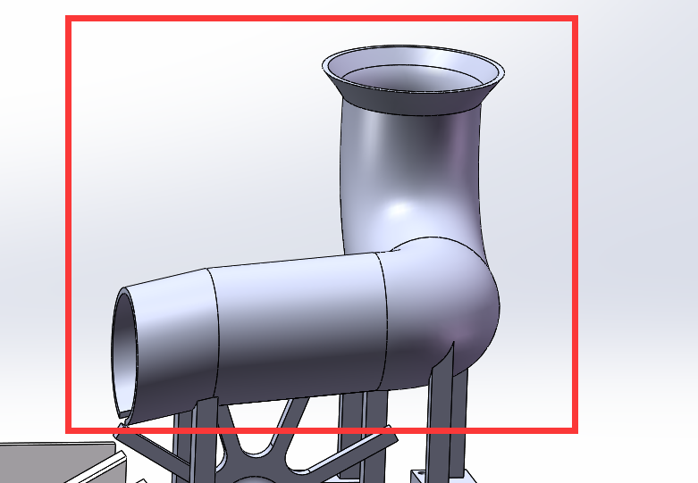
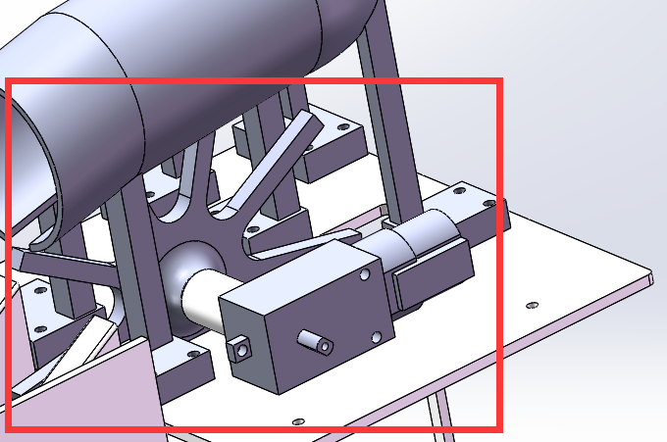
Structure-Function Introduction
Reloading device
Bending duct
Propeller
Huge capacity —— 5 ping-pong balls in at one time
The motor rotates the propeller to drive the movement of table tennis
Notes:
储弹装置是由一个弯曲管道和螺旋桨组成的结构。
我们预计只将乒乓球都放入储弹装置，一次性可以放入5个乒乓球，为此我们将储弹装置设计成弯曲的圆管道，L型的弯曲结构使它能在有限的空间中尽可能增加乒乓球的容纳数量。控制出球的功能是在管道的出口处挖空后，安装一个螺旋桨的结构，通过电机旋转螺旋桨带动乒乓球的运动出球。
The reloading device consists of a curved pipe and a propeller.
We plan to only put ping-pong balls into the reloading device, which can put 5 balls at a time. Therefore, we design the storing device into a curved round pipe, and the L-shaped curved structure enables it to increase the capacity of ping-pong balls as much as possible in the limited space.
The function of controlling the ball is realized through that after hollowing out at the outlet of the pipe and install a propeller, we can drive the movement of table tennis ball by controlling a motor to rotate the propeller.

Slide 14
Structure-Function Introduction
Moving
Reloading
Shooting
Moving
Trebuchet
Shooting
Spacing
Reloading
Remote Controlling
Notes:
过来是发射装置的结构。
And then it is the shooting device.

Slide 15
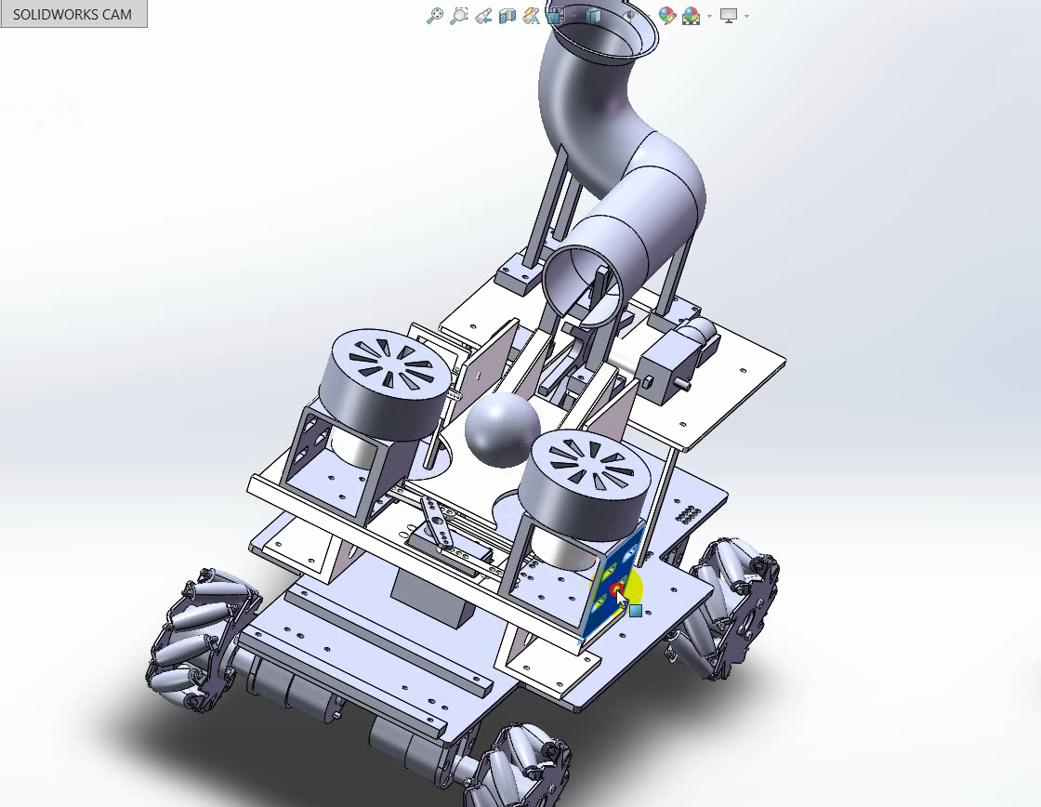
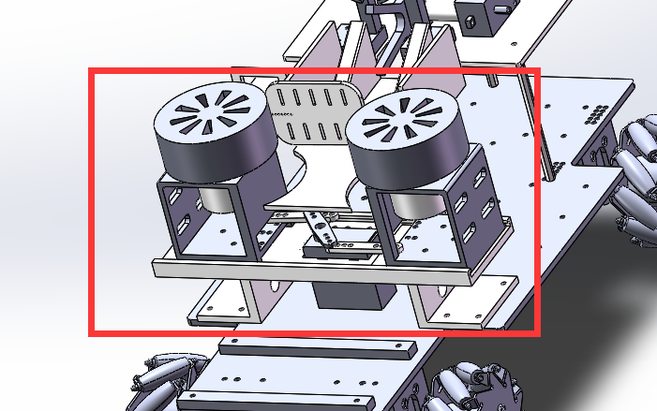
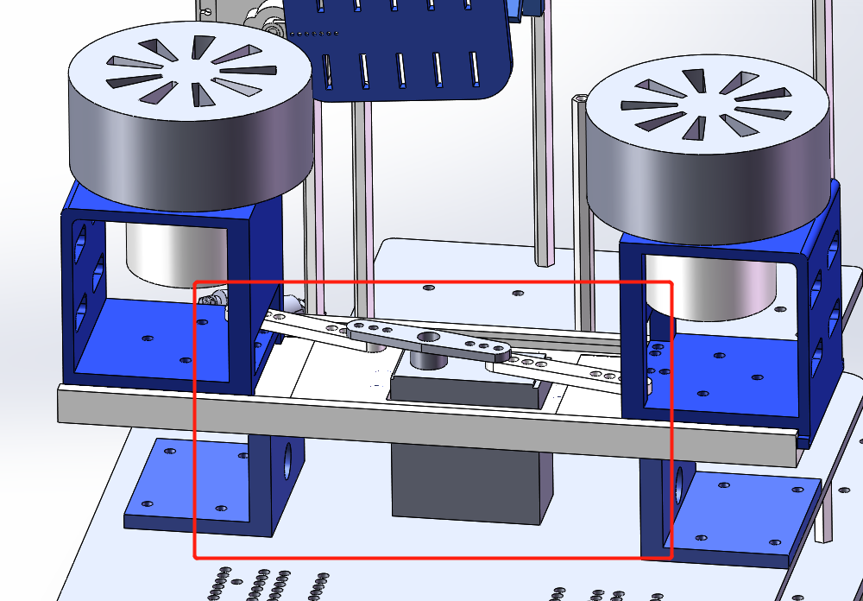
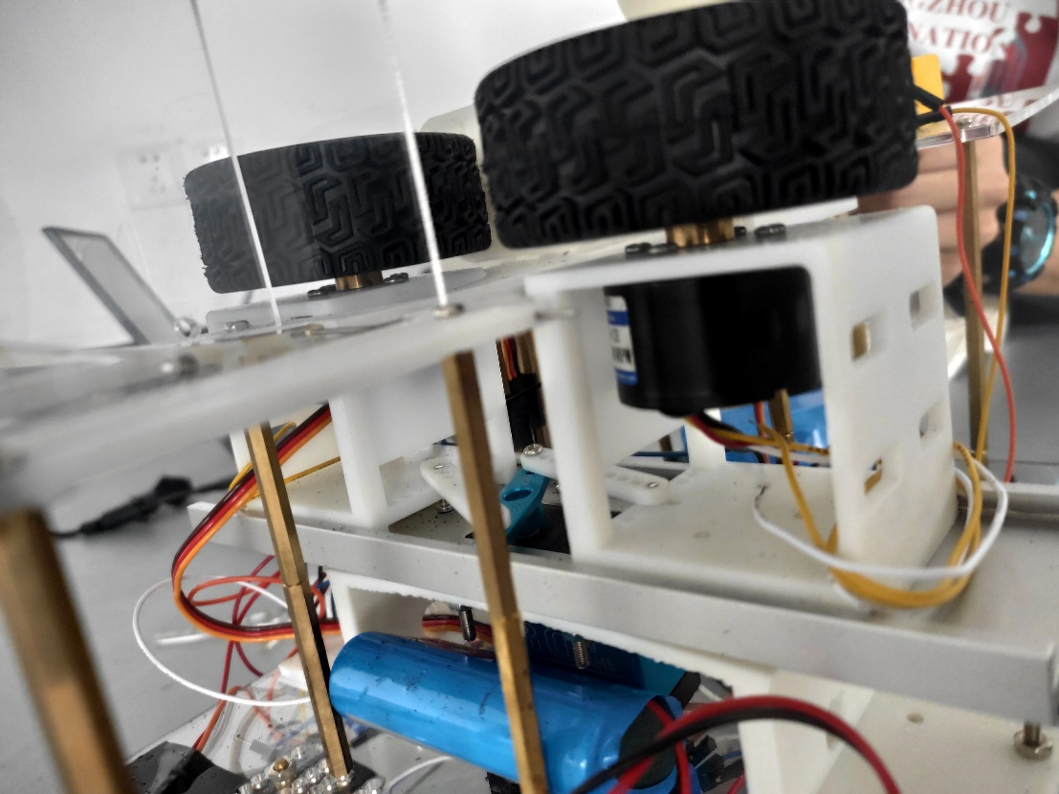
Structure-Function Introduction
Space-adjusting structure
Shooting device
Friction gear firing mechanism
Squeeze and rub the ball and then shot out at high speed
Satisfy long-distance launch trajectory
Trajectory design
Control the ball launch Angle
Prevent the deviation error on both sides
Notes:
这里的发射装置分为两个部分，分别是发射机构+发射轨道。
摩擦轮发射机构：
为了实现球的发射距离能达到要求，就需要给乒乓球足够高的发射速度，而我们采用的方式是，高速运行的摩擦轮实现的摩擦发射。
而发射轨道的设计，
左右两边的亚克力挡板和凹槽式的出射轨道
则是为了更好地控制球的发射角度和防止两边的偏移误差。
关于这里的发射机构，值得强调的是摩擦轮调整间距的结构。
为了适应乒乓球、壁球和网球不同大小的直径，我们配合设计了由舵机驱动连杆带动摩擦轮滑动的结构，像这个视频展示的这样，驱动舵机可以控制摩擦轮之间的间距，从而适应不同大小的球，然后发射。
The launching device here is divided into two parts, respectively, the firing mechanism + Trajectory design.
Friction wheel launching mechanism:
In order to achieve the ball-launching distance can meet the requirements, it is necessary to give balls sufficient speed, and we use the way that, high-speed-running friction wheels achieve the friction launch.
And in the second picture， the design of the Trajectory, which has the Acrylic baffles on the left and right sides and the grooved ejection tracks，
is to better control the ball launch Angle and prevent the deviation error on both sides.
About the launching mechanism here, it is worth emphasizing that space-adjusting structure of frictiongears.
in order to enable firing mechanism adapt to the different diameters of table tennis balls, squash balls and tennis balls, we designed this structure that the steering gear drives the connecting rod to drive the friction wheels to slide.
As shown in the video, driving steering gear can control the spacing between the friction wheels to adapt to the balls of different sizes and then launch.

Slide 16
PART Ⅲ 
03
Manufacturing
Structure
Electronic control
Group 5

Slide 17
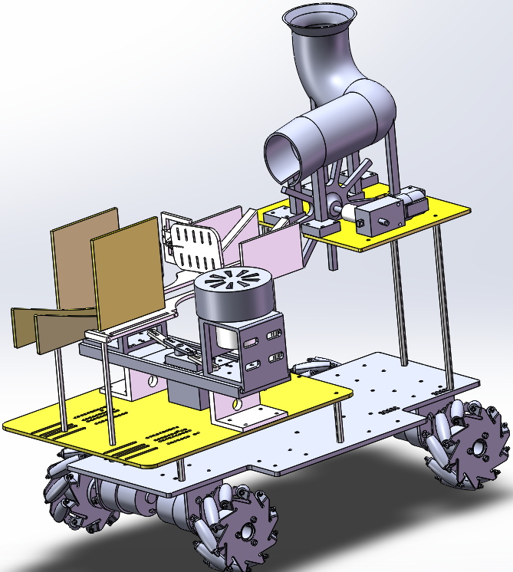
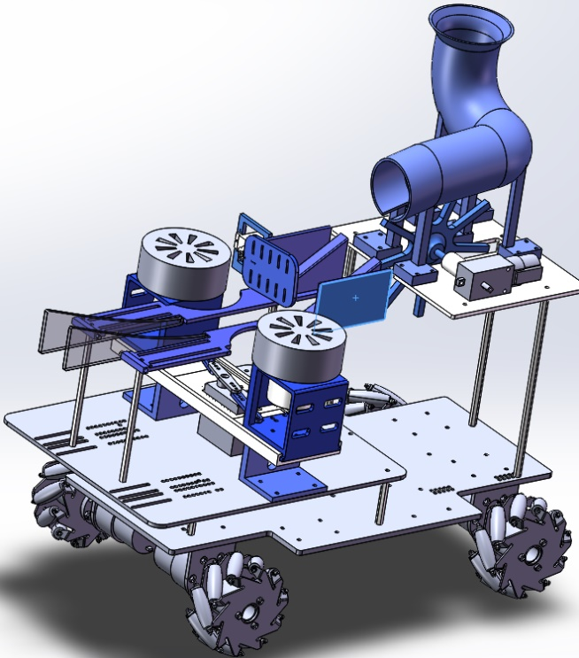
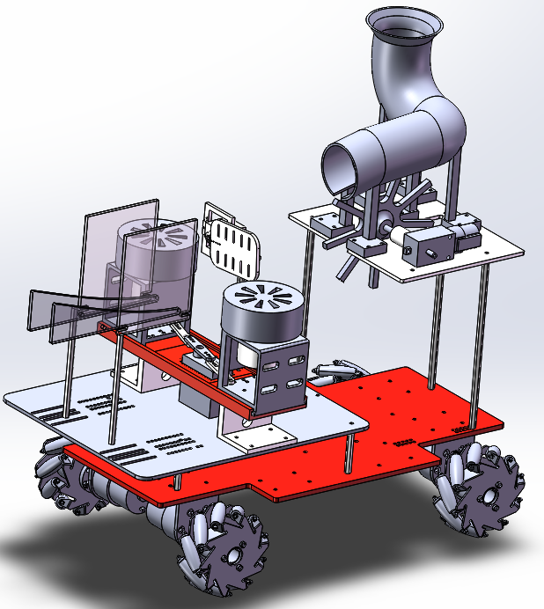
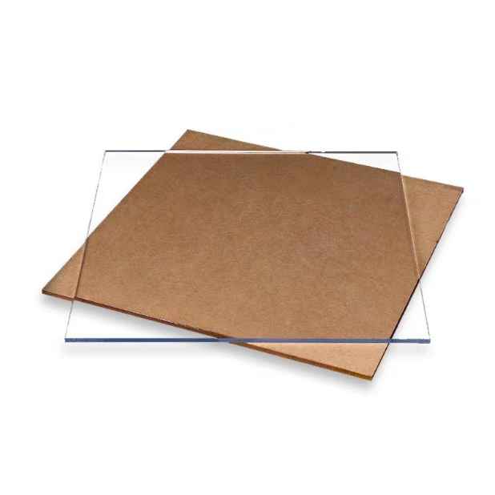
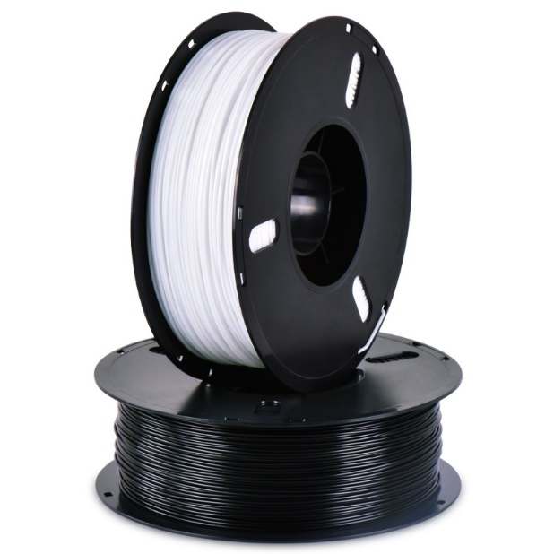
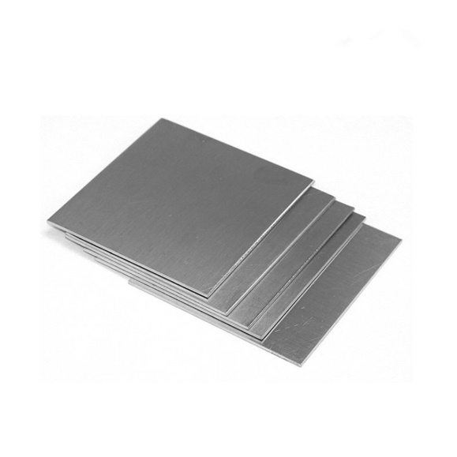
Material Selection
Acrylic Board
PLA
Steel
Applying Laser cutting technics to acquire plane structural components
Using 3D modelling, we can design whatever shape we desire, but the fitting and accuracy of products can not be very promising.
Considering its high sustainability, we utilize modelling analysis to see which part needs to be stronger than others.

Slide 18
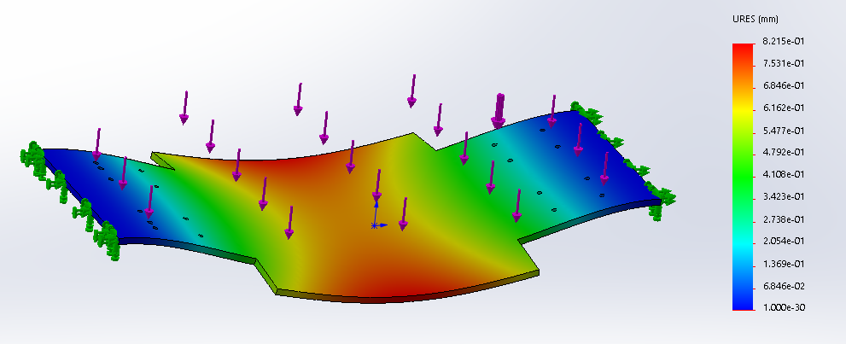
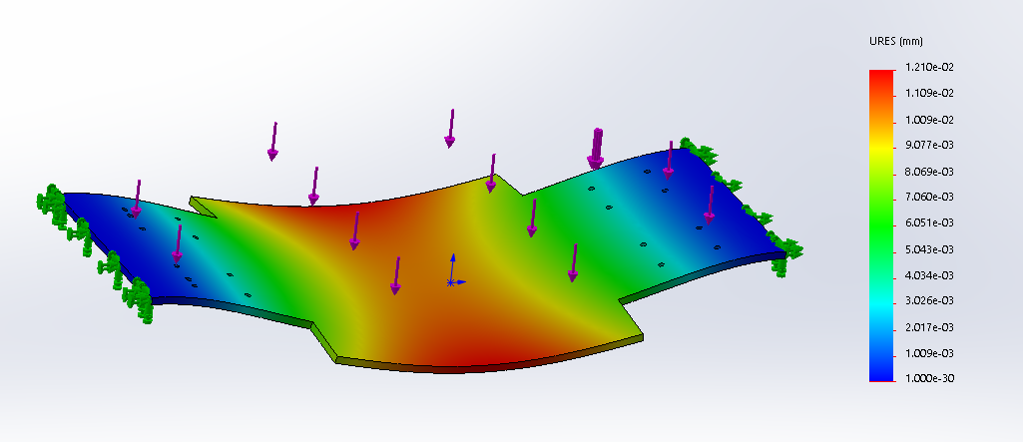
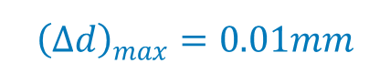
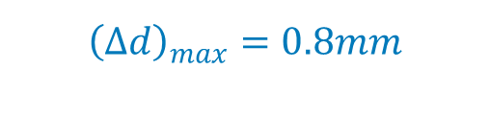
Bottom Plate
Principle of selection: High tolerance.
Acrylic Board
Steel
$${\left(∆d\right)}_{max}=0.8mm$$
$${\left(∆d\right)}_{max}=0.01mm$$

Slide 19
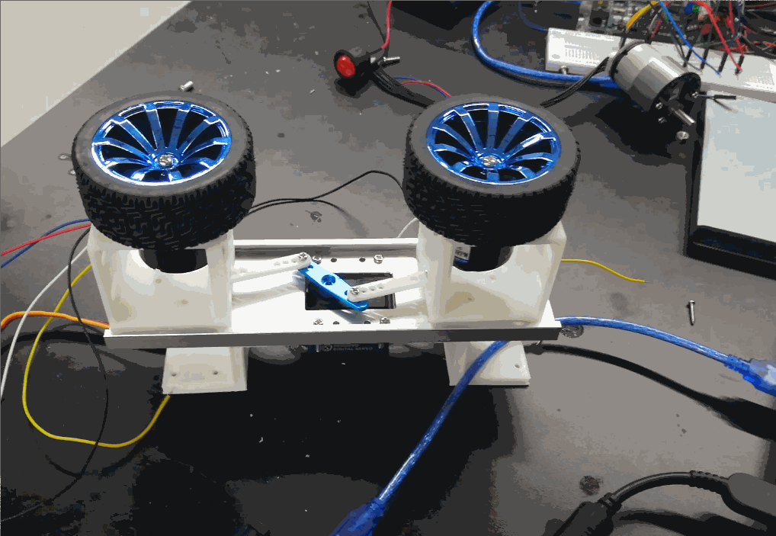
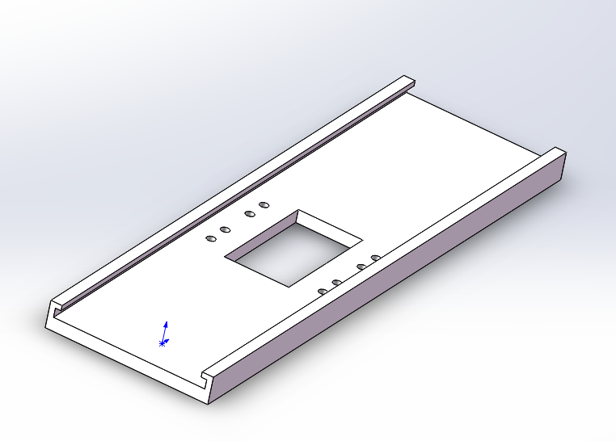
Slide rail
Principle of selection: Smooth.
The products manufactured by 3D print always have a rough surface.
So we choose stainless steel as material, and applying wiredrawing surface treatment.

Slide 20
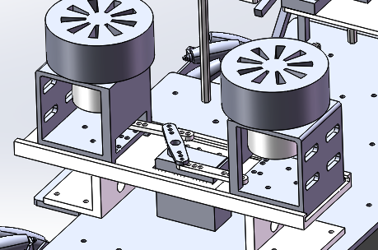
Details in Design:
The key point of design
Minimize the friction between the motor bracket and sliding rail.
Improve the strength of the mechanism to resist the stress produced by the contact between the friction wheel and the ball.
Friction Wheels ’Spacing Adjusting Mechanism

Slide 21
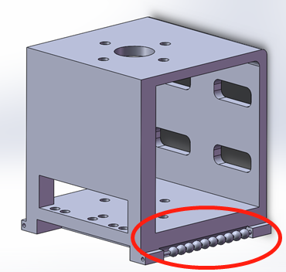
Method(Ⅰ) to Reduce Friction
Steel balls are installed at both sides of the motor bracket and the sliding rail.

Slide 22
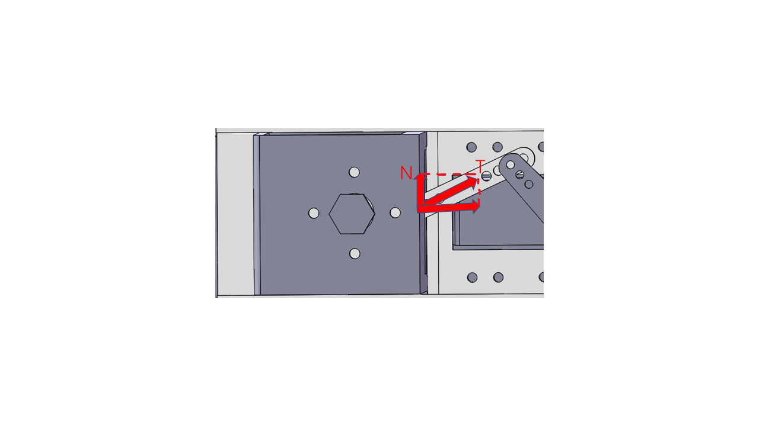

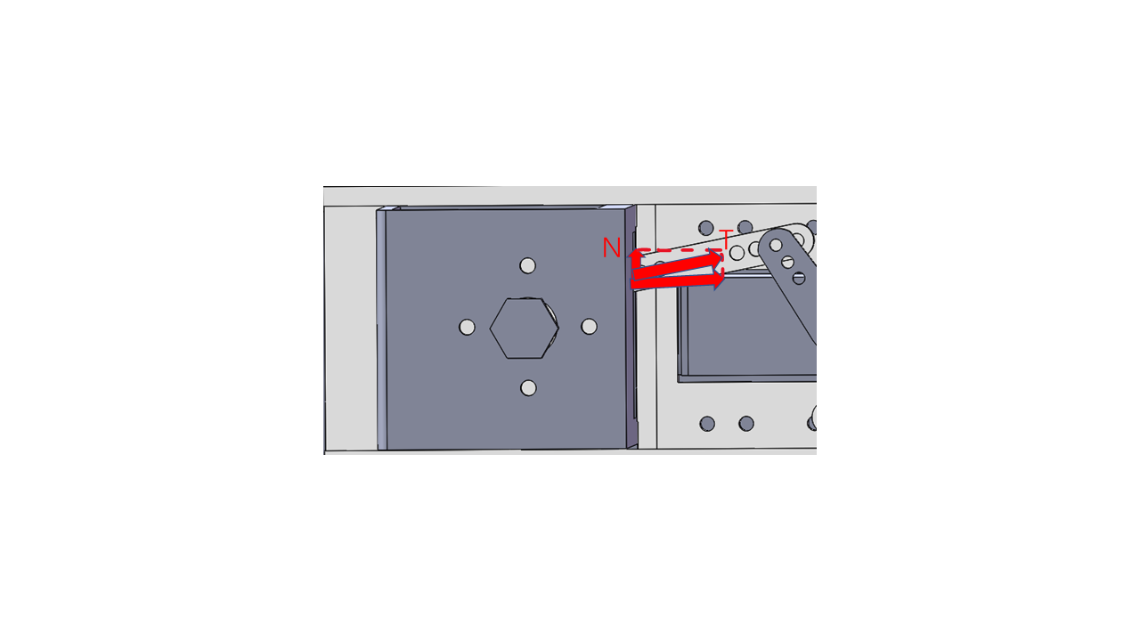

Method(Ⅱ) to Reduce Friction
Change the installation position of the transmission rod to reduce the normal force, so as to reduce the friction.

Slide 23
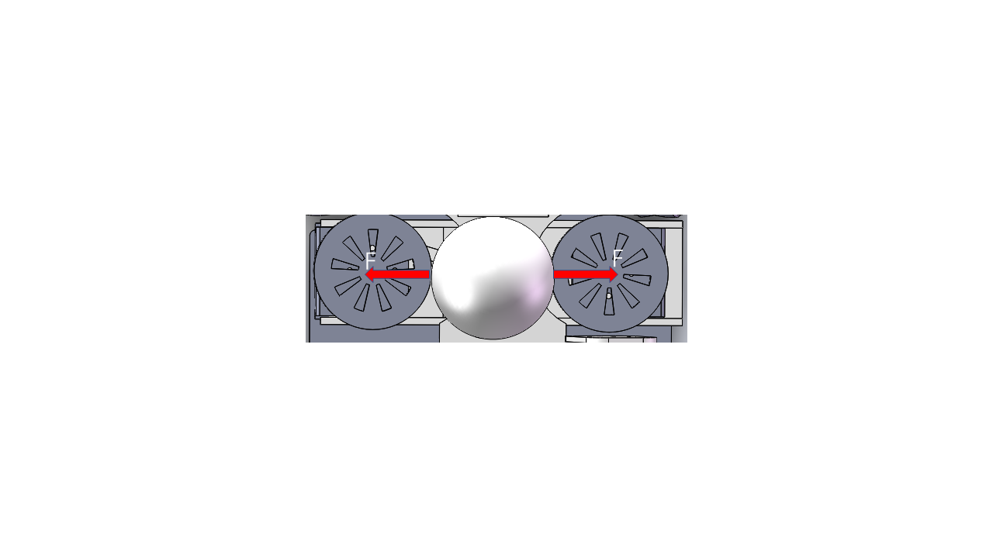
Improve the Stability of the Shooting Device
The ball will produce a large force on both sides of the friction wheels at the moment that the ball contact with the high-speed friction wheels.

Slide 24
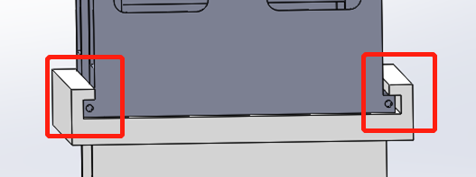
Method (Ⅰ) to Improve the Stability
The groove is used to limit the movement of the motor bracket in the vertical direction.

Slide 25
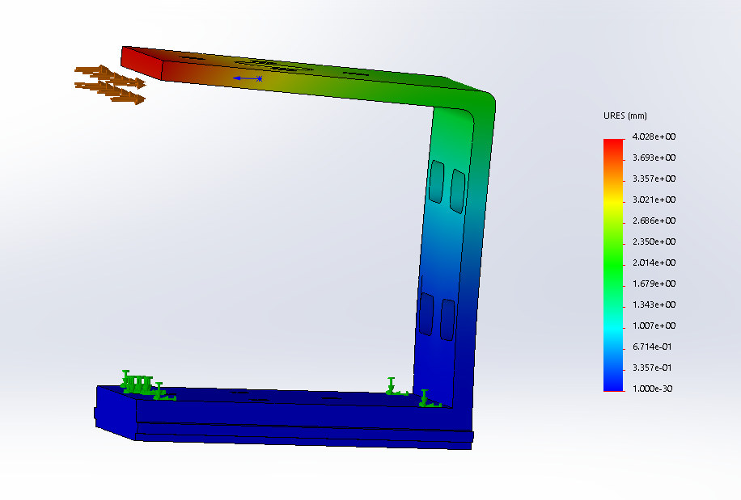
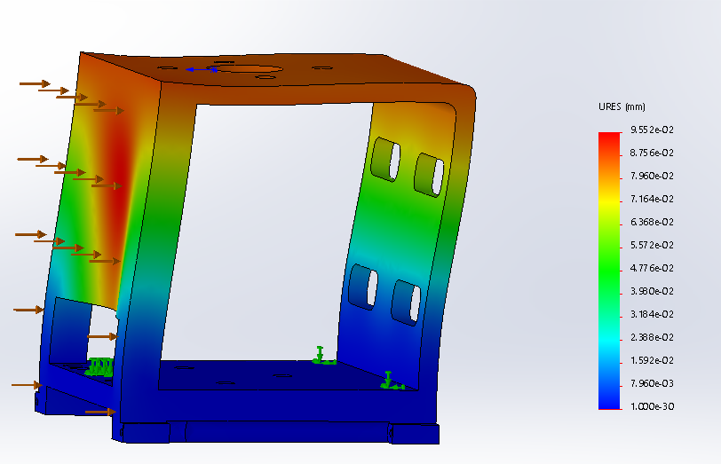
Method (Ⅱ) to Improve the Stability
Applying O-shape instead of C-shape for the motor bracket.

Slide 26
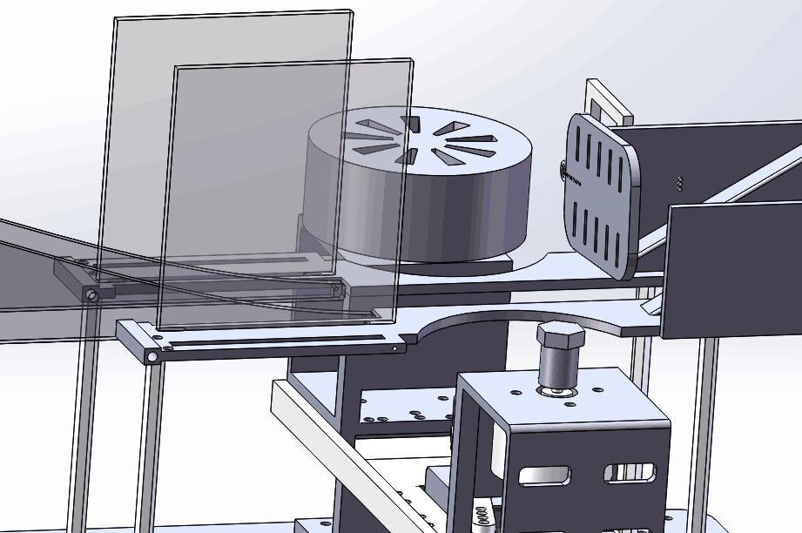
Details in Designing the Shooting track
The key point of design
Restricting the ball to move along the vertical bisector of the line connecting the two friction wheels.
Adapting to different balls.
Shooting with an appropriate pitch angle.
Shooting Track Position Limitation
Notes:
We think there are three Key points of designing this shooting track.
Let see how we interpret them.
Restriction: The track lets the ball go in the middle;
Adaption: The track functions normally despite the different sizes of balls;
Angle: The track should be able to alter the direction of the initial velocity.
How do we implement this?

Slide 27
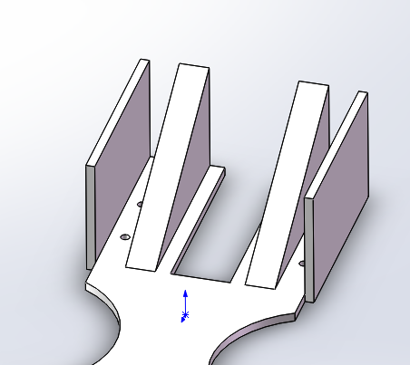
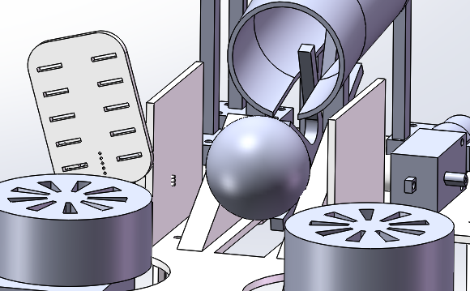
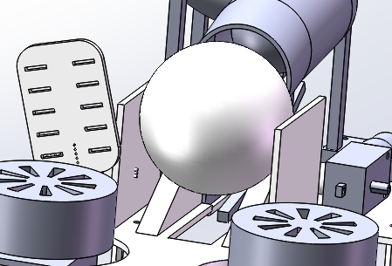
Method (Ⅰ) to limit the Balls before Shooting
The groove is used to restrict the balls.
Baffles are added to prevent the ball from slipping out so that we can shoot whenever we want.
Notes:
Now, let’s start looking into the details from the back to the front.
A inclined groove with only two supports. No matter…
The electrically controlled baffles in the front the groove can help us put the ball in an appropriate position for the shooting , with a little help of the gravity.

Slide 28
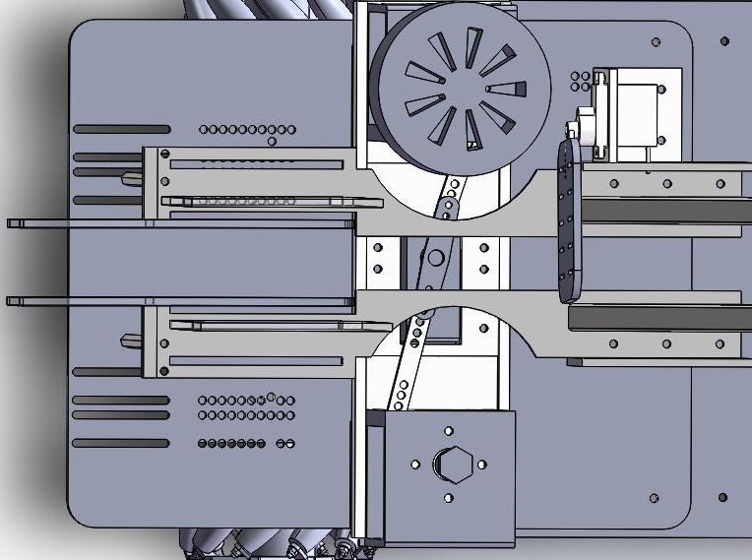
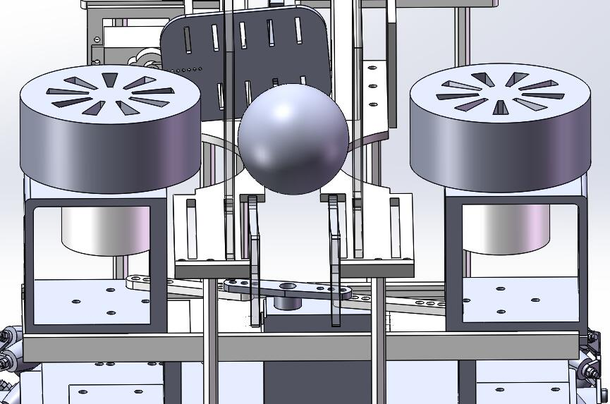
Method (Ⅱ) to limit the Balls before Shooting
keeping the ball at the center until it is shot.
Making sure that our wheels apply the same friction on both surfaces.
Notes:
Next, take a top view of our track.
You can see that the groove actually goes from the back all the way to its front.
Also, with the center position, the friction applied by the wheels can roughly be the same, thus, shoot the balls in a rather straight line.

Slide 29
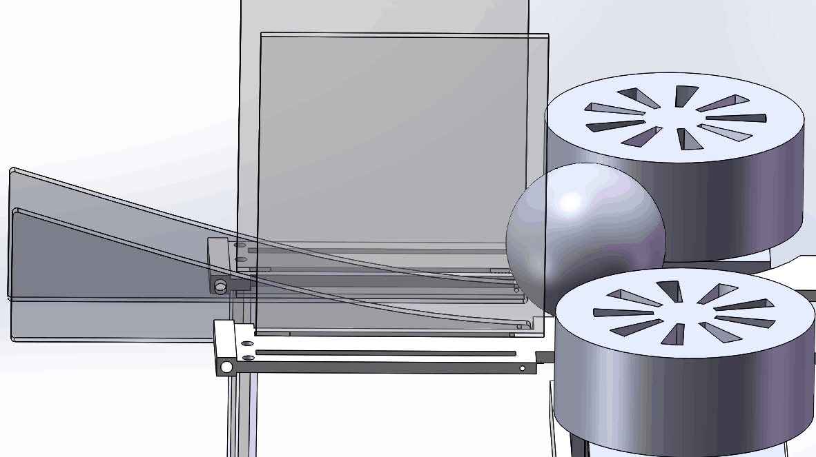
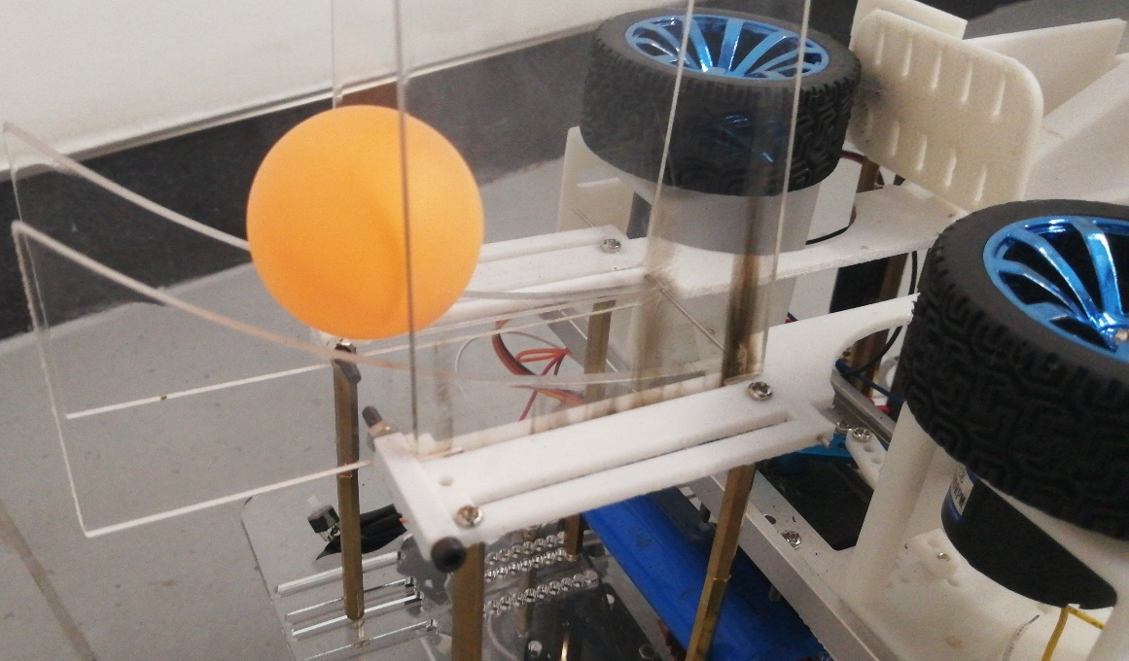
Limit the Balls while Shooting
The shooting track also consists of two supports only.
Two vertical baffles on both sides to limit the horizontal position of the shot balls.
Notes:
After the friction is applied, we add two vertical baffles on both sides so that the balls can be even better limited in a straight line.

Slide 30
PART Ⅲ 
03
Manufacturing
Structure
Electronic control
Group 5

Slide 31
Electrically Controlled Components
They are equipped to realize five main systems.

Slide 32
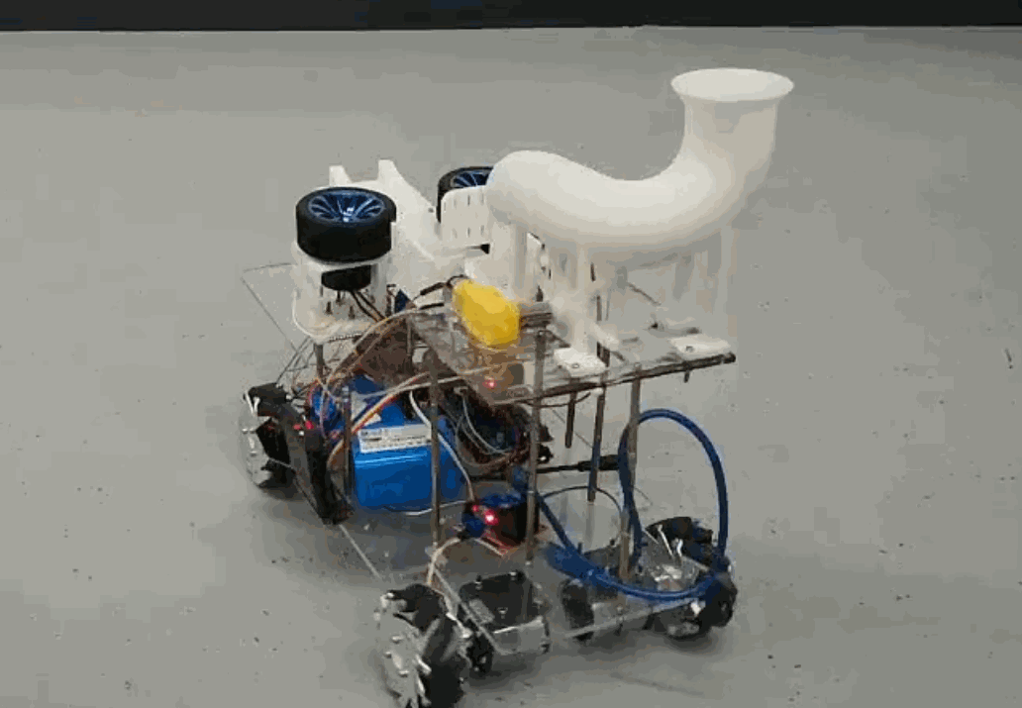
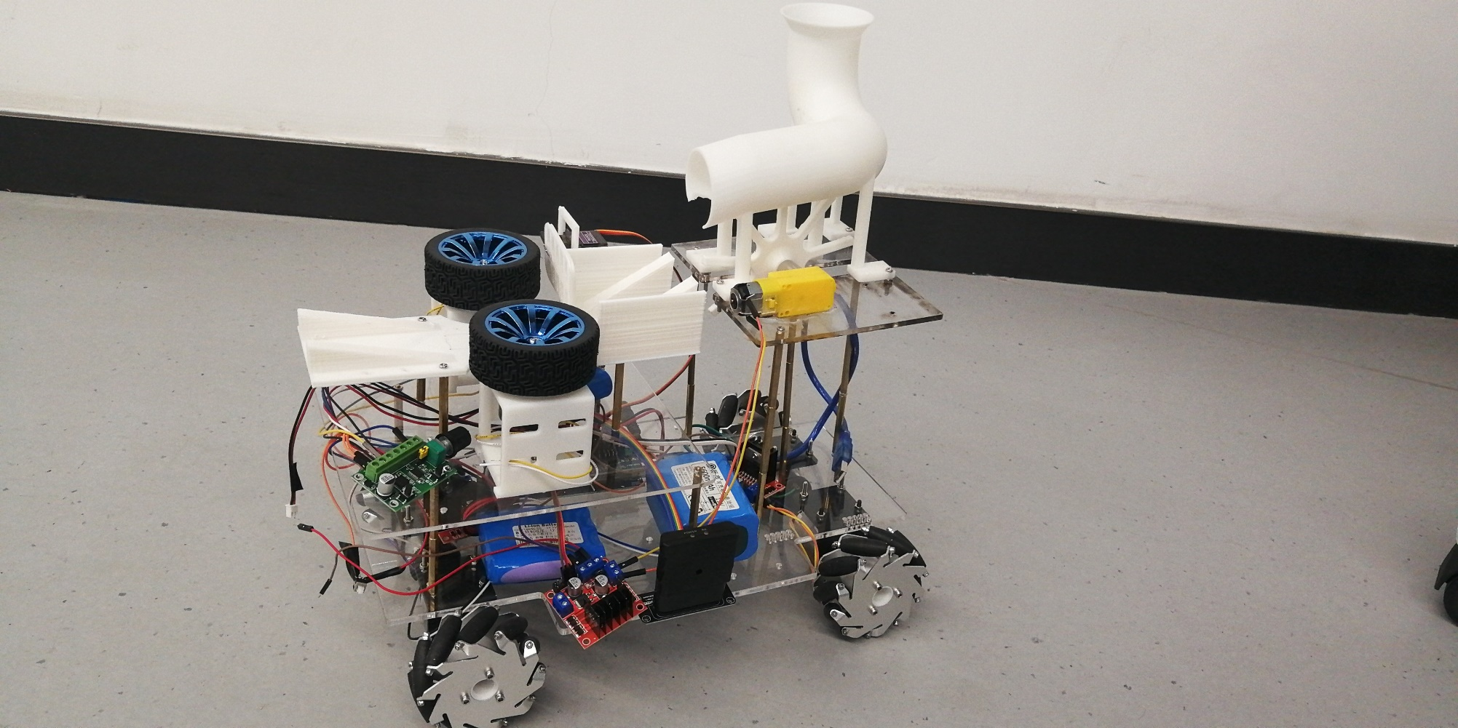
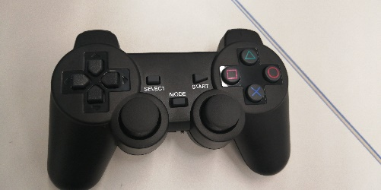





Electrical Control -Remote and stable
Remote Controlling
Reloading
Shooting
Spacing
Moving
Moving
Shooting
Trebuchet
Spacing
Reloading
Remote Controlling

Slide 33
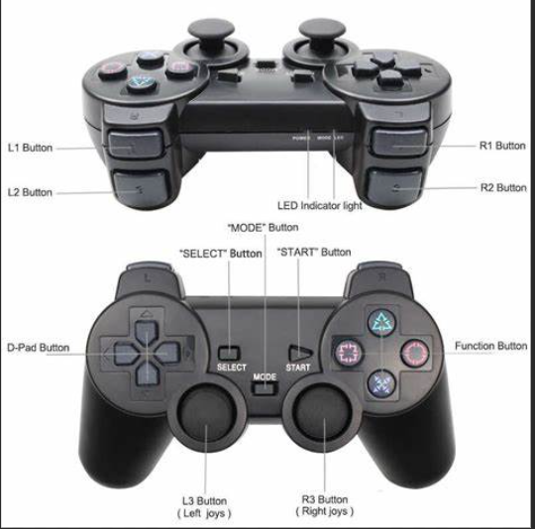

Electronic Control-Operation and Performance
We successfully assign different functions to different buttons and joystick status.
All components can function as an integrated system.

Slide 34
PART Ⅳ 
YOUR SLOGAN HERE
04
Cost Estimation

Slide 35

Cost Estimation
The total budget is 2500 yuan.

Slide 36




Cost Estimation
3D printing
Mecnum Wheels
About 270 yuan.
260 yuan
800yuan for structure
Acrylic sheet
Others
95 yuan
175 yuan

Slide 37

Cost Estimation
Battery
We use 7.4v and 12v battery which totally cost 250 yuan.
Motors for
Mecnum wheels
Motors for
friction wheel
Four motors for Mcnum wheels cost us 90 yuan.
Six motors for friction wheels cost us 360 yuan.

Slide 38





Cost Estimation
Three Arduino maga and the related development board cost us 260 yuan.
Arduino maga
L298N
PWM Servo
640 yuan for control
Five L298N cost us 60 yuan.
Five PWM Servo cost us 120 yuan.
The Bluetooth handle
Other control modules
The bluetooth handle cost us 53 yuan.
About 140 yuan

Slide 39
PART Ⅴ 
YOUR SLOGAN HERE
05
Conclusion
Structure
Time Management
Cost Estimation
Actural Effect
Group 5

Slide 40


Structure
Module diagram and actual result diagram

Slide 41



Structure
Moving
Reloading
Shooting
The unique structure of our design makes our car have high flexibility, controllability., stability, high load capacity and powerful shooting ability.

Slide 42

Time Management
Stick to a strict schedule

Slide 43
Cost Estimation
Still have 175 yuan left.

Slide 44

Actual Effect
Test Result
In the process of shooting, the trebuchet maintains a very high stability, and the ball has a precise direction of trajectory.

Slide 45
THANKS FOR WATCHING
Group Five

